Slide 1
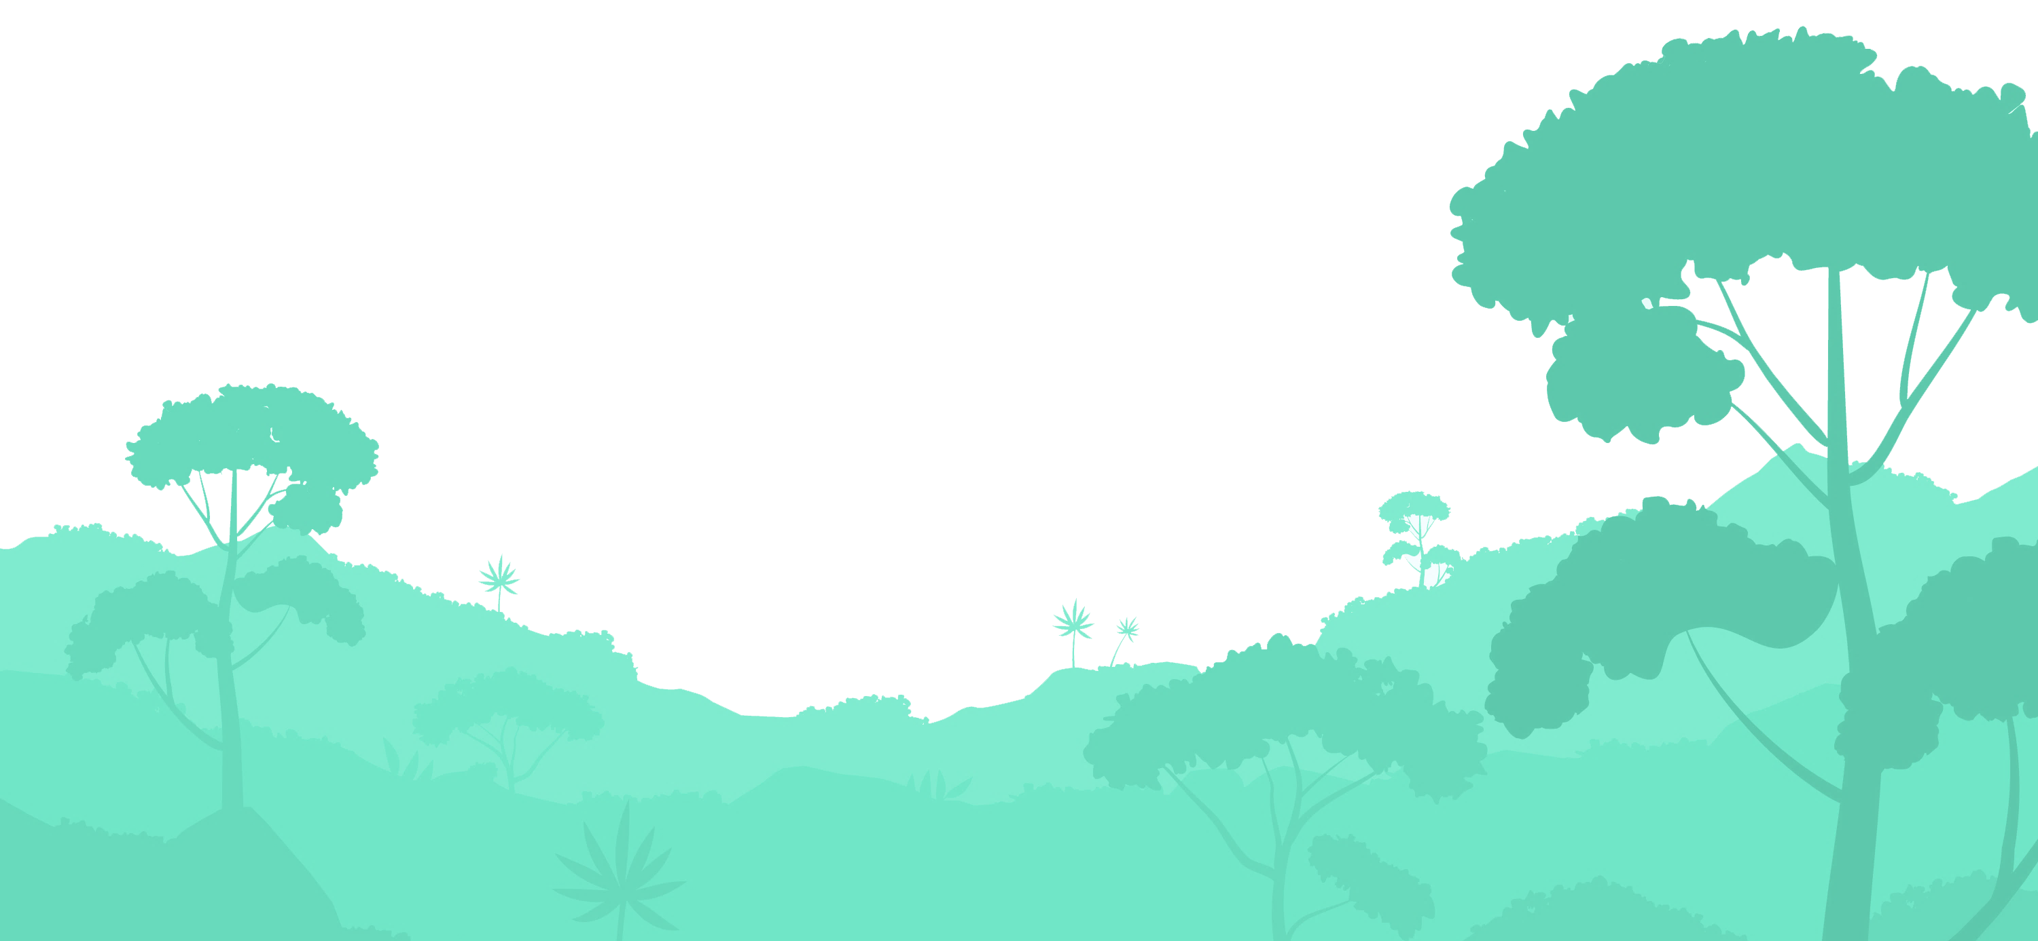
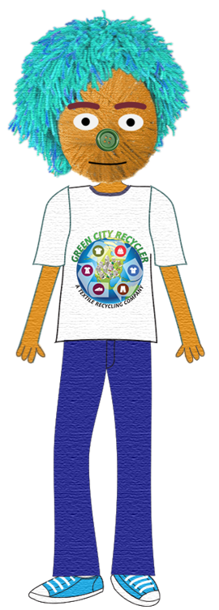
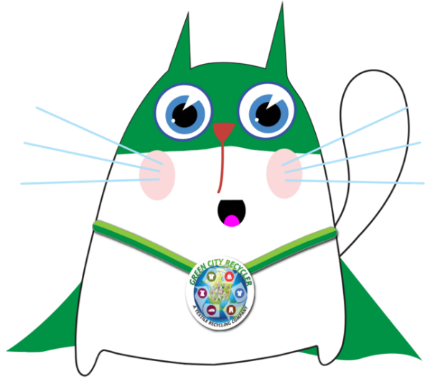
Presents
The Adventures of
Rex and Yarn

Slide 2
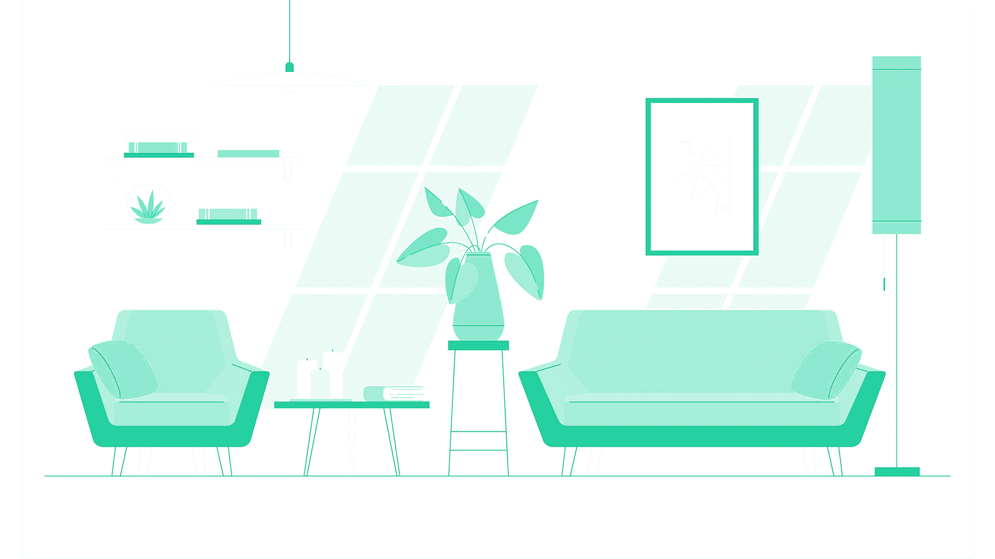
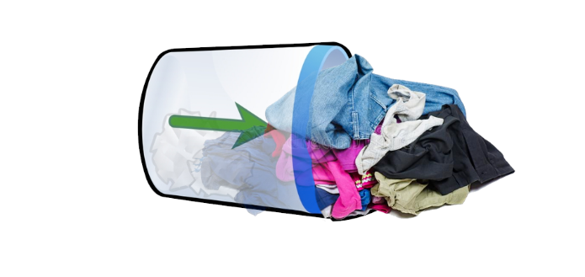
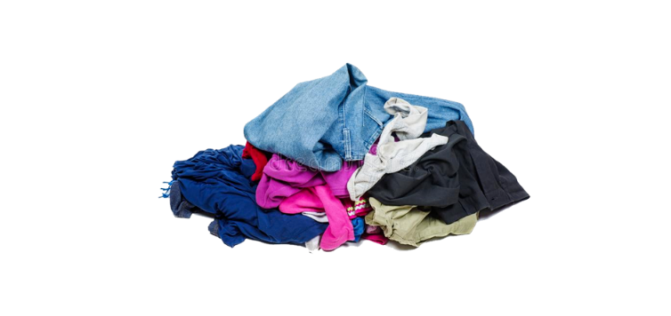
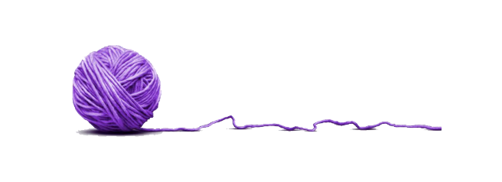
Hey Yarn, want to play catch with m- Wait!
Don't tell me you are throwing away
your used clothes!

Slide 3
The Adventures of Rex and Yarn.
That right there... you see that? That is the one of Largest Polluters in the world! Every year, clothes that can fill 310,000 trucks are dumped into landfills in America! I just watched a show the other day where clothes exactly like these were clogging up large pieces of land!
Just doing a little bit of spring cleaning. You know... just sorting through old sweaters and socks and sweatshirts and pants. Once I do that, I can throw away ALL the clothes that I don’t need. Why d'you ask?

Slide 4
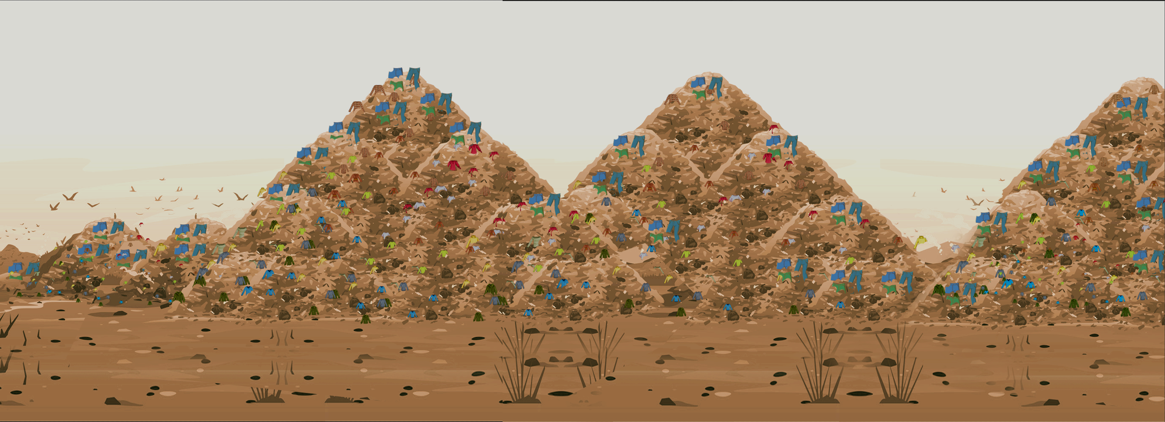
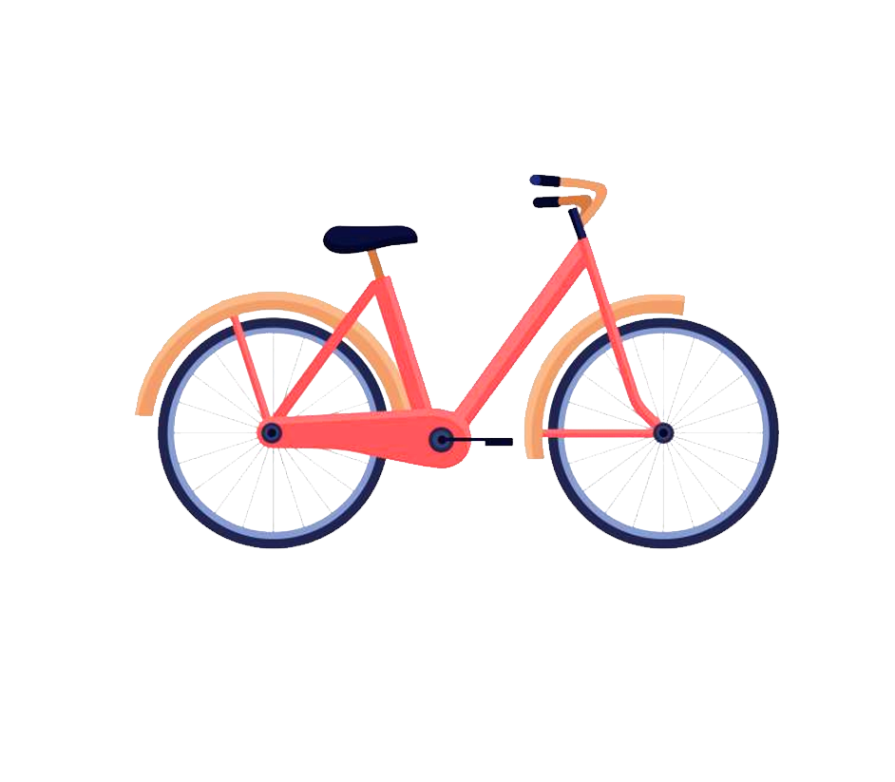
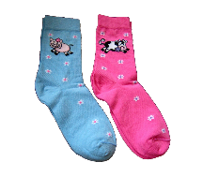
What? You mean my socks are causing pollution? Come on! They don't stink that bad!
Climb on and I'll take you to a landfill. Maybe you'll get why I am so upset.

Slide 5
Y'know when you leave a half eaten apple lying around for days? It gets all mushy and gooey. Well, that's a good thing! When you bury it into the soil, it disappears and becomes a part of the soil. So, that's why we say an apple is biodegradable!
And my sock is not bio... biodeeee gabble dabble??

Slide 6
Really !?! That’s interesting but ewwwww I've never seen so many dirty, wet
clothes in my entire life! This is bad, isn't it?
Nope! Your socks and your favourite sweatshirt are not Bio-de-grad-able. So instead of disappearing into the soil, they pile up and up and up and up into the sky! Just like this place! 95% of clothes that have been thrown away here could have actually been recycled!

Slide 7
POP QUIZ!
Landfills are very large and really smelly!
True
false
Upcycling and Recycling used clothes are
NOT the best thing for the planet.
True
false
95% of textile waste can be recycled.
True
false
When people donate clothing to charities, it
makes them happy!
True
false

Slide 8
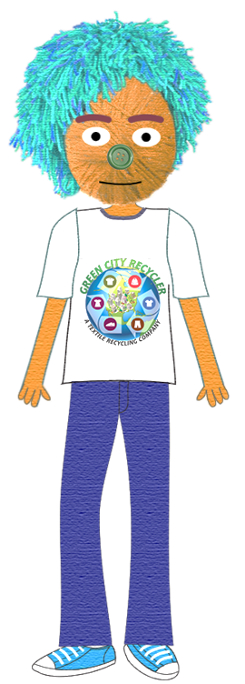
It is! Real bad! And you know what else I found out?? Each family in America throws out 70lbs of clothes every year! Imagine if all that clothing was collected into one place! Just imagine how big those piles will be!
No wonder those piles of clothes are growing bigger and bigger and higher and higher!
What are we going to do?

Slide 9
The Adventures of Rex and Yarn.
What if I fall off the planet and the mountains of t-shirts take over the earth?
What if I can't ride my bike anymore 'coz the roads are covered with pants?
What if I have to sleep in my room on top of icky, stinky piles of socks?
What if I can't play in the park because the slides and the monkey bars are covered in scarves and sweaters?
Question for the Class:
How would your life be different if whatever Yarn is imagining happens to you??

Slide 10
The Adventures of Rex and Yarn.
Yarn! Yarn! Relax! Yes, we do have a lot of pollution because of used clothes, or textile waste, that we dump in landfills. But we can do two things to help save the planet... you know, just in case t-shirts decide to take over the world.
Whew! We can? Tell me! Tell me! What are they!?!

Slide 11
The Adventures of Rex and Yarn.
First, we can upcycle! No, Yarn! I'm not talking about cycling into the sky. This is when you use something differently from the way you first used it. It's like when you poured paint on your favorite jeans and can't wash it out. Do you throw them away? No! You can cut them at the knees and use them as shorts!
Question for the Class:
What are some of the interesting ideas you have on how to use an old piece of clothing in a new way? Do you use any of these great ideas at home?

Slide 12
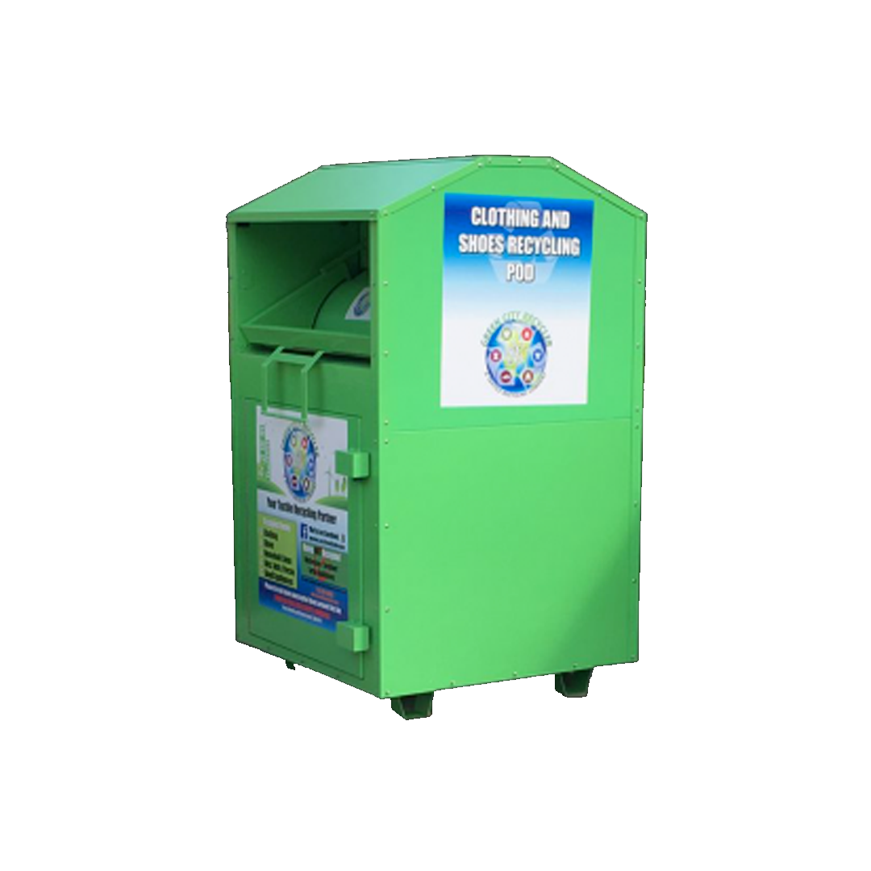
The Adventures of Rex and Yarn.
The second way to make sure t-shirts don't take over the world is if you send your clothes for recycling. GCR has a clothes pod right outside where you can put your textile waste - your used clothes. The clothes then get recycled and are made into new clothes and other useful things!
Question for the Class:
Do you have any idea what happens to clothes that are sent for recycling?
Any guesses?

Slide 13
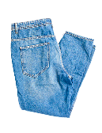
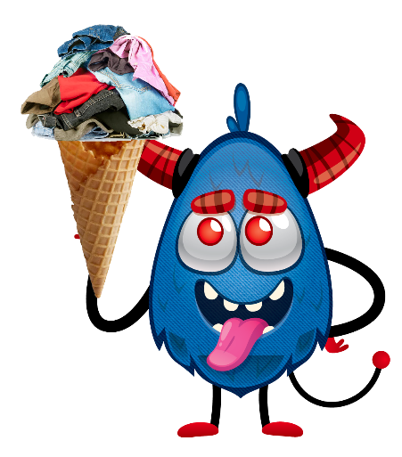
The Adventures of Rex and Yarn.
And what if both these things don't work?? What if we can't upcycle or recycle all the clothes in time?
Then we'll just have to bring in my pet monster, Tex. He loves munching on a fluffy sweater and crunching on flip flops. It's a good thing he's always hungry!

